Slide 2
ExaCC & ExaCS Patching Best Practices
Cloud at Customer
Marcel Rosa/Mauricio Sarai
Notes:
- Apresentar sobre o welcome meeting
Primeiramente sejam bem vindos essa é a nossa welcome meetig, gostaria de agradecer por terem optado em utilizar nossos produtos/serviços Oracle como solução de TI de vocês.
Apresentar pessoas do time Cloud Specialist
Faço parte do time de Cloud Specialist aqui na Oracle em conjunto com Marcel e Yuri, inicialmente quem irá suporta-los será o Yuri Paes, porém essa primeira reunião eu irei conduzi-los.
Apresentar pessoas que estão no call do lado Oracle
Tech Sales representative
Systems Representative
Install Coordinator - Dana / Karina – coordena as atividades de deploy
Hardware Engineer Team
Solicitar a apresentação do cliente
Coletar as informações dos pontos de contato do cliente.

Slide 3
Safe harbor statement
The following is intended to outline our general product direction. It is intended for information purposes only, and may not be incorporated into any contract. It is not a commitment to deliver any material, code, or functionality, and should not be relied upon in making purchasing decisions.
The development, release, timing, and pricing of any features or functionality described for Oracle’s products may change and remains at the sole discretion of Oracle Corporation.
Notes:
Declaração de Porto Seguro

Slide 4

This Session
Before Patching
Roles & Responsabilities
Exachck
Proactive SR
VM Backup
Infrastructure Maintenance Backups
Updating Cloud Tooling
Patching Dom0
Configure Oracle Managed Updates
Configure Maintenance Method
Check Estimated Maintenance Time

Slide 5
This Session
Patching DomU
DomU Update Best Practices
Patching and Updating DomU Using Console
Using Console to Move DB to Another Home
Patching GI and DB Using dbaascli
Moving DB to a different Oracle Home
Patching GI and Oracle Home using dbaascli
Updating Guest VM Manually
Executing patchmgr in background

Slide 6


Before Patching …
Cloud
ExaCS / ExaC@C
Roles & Responsibilities
User-Managed Maintenance Updates
Patching the Oracle Grid Infrastructure and Oracle Database software on the Exadata compute nodes;
Updating the operating system and the tooling on the compute nodes.
Oracle-Managed Infrastructure Maintenance Updates
Oracle manages quarterly infrastructure maintenance updates of all other infrastructure components, including the physical compute nodes (Dom0), the Exadata storage servers, and the Exadata network switches.
Data/Schema
Customer
DomU
Databases
SO
Hypervisor
Oracle
Dom0
Internal Fabric
Storage
Storage
Confidential – © 2022 Oracle Internal/Restricted/Highly Restricted
Notes:
Realizar comparações entre os formatos de serviços Exadatas.
Autonomous Transaction Processing and Autonomous Data Warehouse

Slide 7
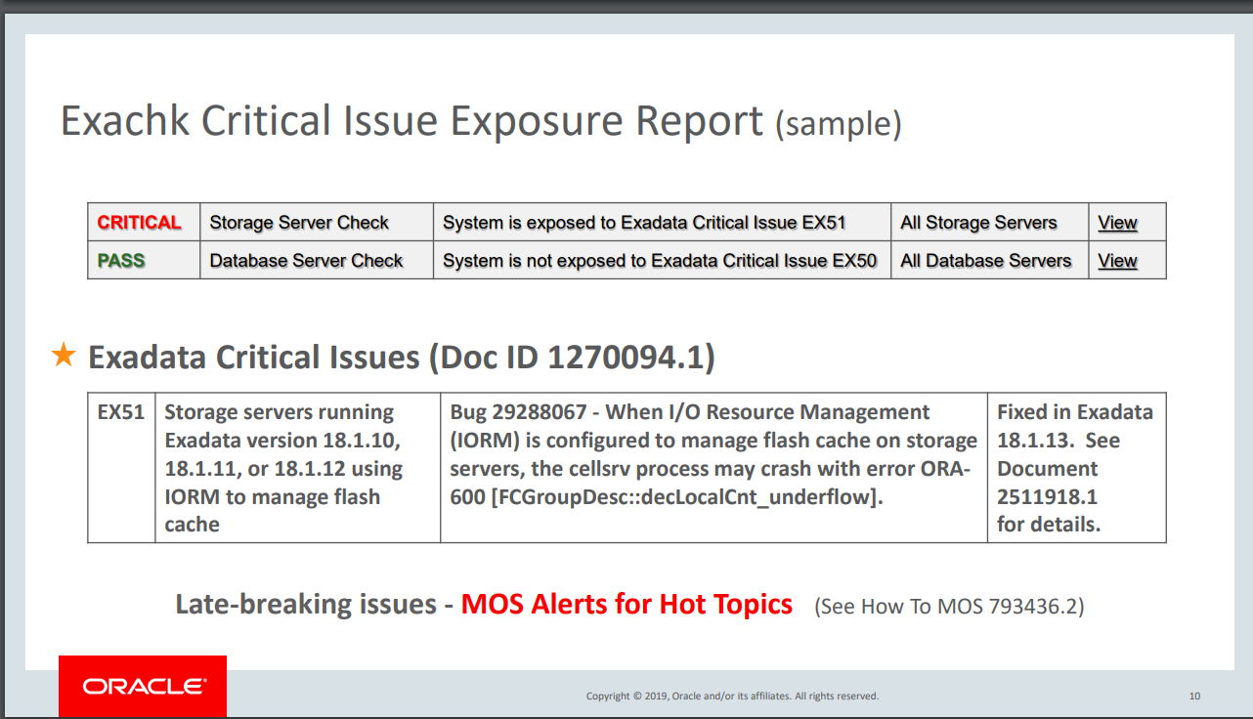
Before Patching …
Exachk
Exachk holistically evaluates Exadata Database Machine engineered systems;
Execute Exachk 10 days before patch date and analysis the result and score;
Open a proactive SR in order to review the exachk;
Reference: Oracle Exadata Database Machine EXAchk (Doc ID 1070954.1)
Confidential – © 2022 Oracle Internal/Restricted/Highly Restricted
Notes:
A Oracle disponibiliza Patches de segurança e vulnerabilidades a cada quarter para todos os componentes do ExaC@C Dom0 e DomU

Slide 8
Before Patching …
Open a proactive SR before maintenance date
Open a Sev2 SR days before maintenance date and before start the maintenance change SR to sev1 24/7
Reference: How To Request Management Attention on a Service Request (SR) with Oracle Support Services (Doc ID 199389.1).
Confidential – © 2022 Oracle Internal/Restricted/Highly Restricted
Notes:
A Oracle disponibiliza Patches de segurança e vulnerabilidades a cada quarter para todos os componentes do ExaC@C Dom0 e DomU

Slide 9
Before Patching …
VM Backup
Customer is responsible for managed virtual machine backups
A backup can be performed from inside the virtual machine;
Oracle recommends a backup before and after virtual machine maintenance.
Reference:
Exadata Cloud Compute Node Backup and Restore Operations (Doc ID 2809393.1)
Oracle Cloud managed virtual machine backups
The backup runs automatically once a week;
One backup copy is retained;
Backup is executed only if space exists;
These backups can be used to resurrect a virtual machine that may have been completely damaged to the extent that it may not boot.
Confidential – © 2022 Oracle Internal/Restricted/Highly Restricted
Notes:
A Oracle disponibiliza Patches de segurança e vulnerabilidades a cada quarter para todos os componentes do ExaC@C Dom0 e DomU

Slide 10
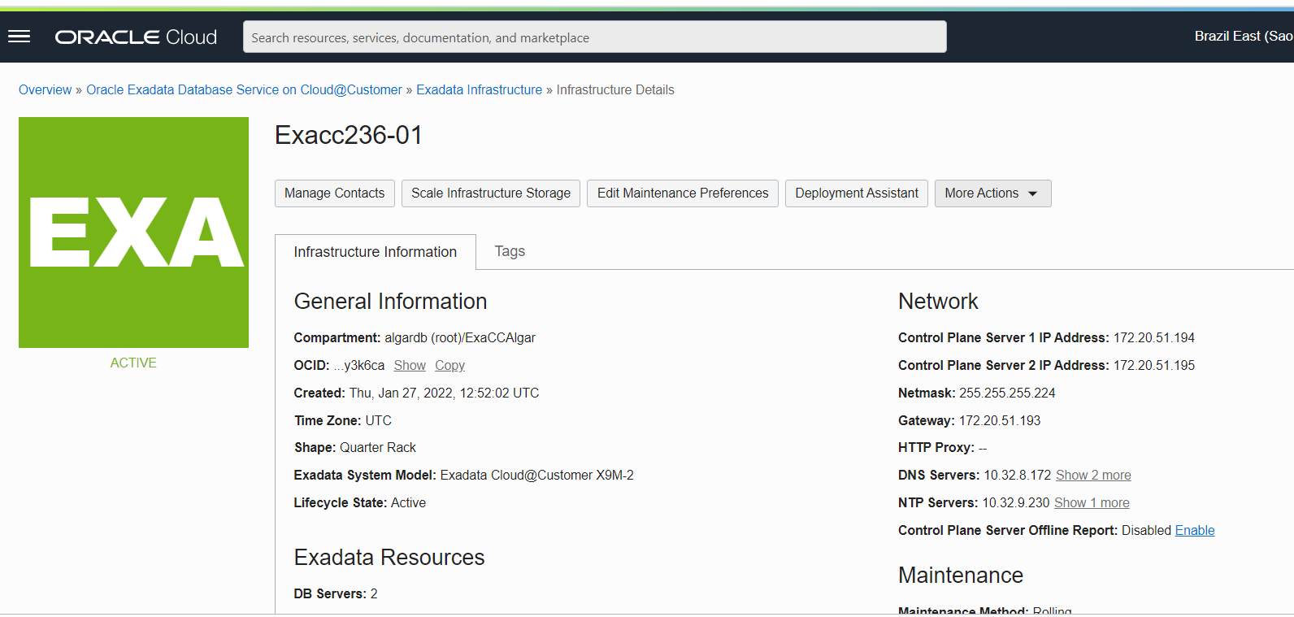
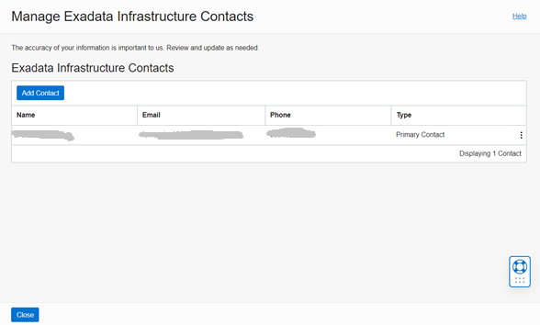
Before Patching …
Infrastructure Maintenance Contacts
Maintenance contacts are required for events like patching and HW maintenances;
Add a primary maintenance contact and optionally secondary contacts.
Confidential – © 2022 Oracle Internal/Restricted/Highly Restricted
Notes:
A Oracle disponibiliza Patches de segurança e vulnerabilidades a cada quarter para todos os componentes do ExaC@C Dom0 e DomU

Slide 11
Before Patching …
Updating Cloud Tooling
To update to the latest available cloud tooling release, run the following command:
dbaascli admin updateStack
The command takes care of updating the cloud tooling release on all the nodes of the cluster.
Reference: How to upgrade DBAAS Cloud Tooling using dbaascli (Doc ID 2350471.1)
Note: Apply just to ExaCC environment, ExaCS is updated automatically by Oracle.
Confidential – © 2022 Oracle Internal/Restricted/Highly Restricted
Notes:
A Oracle disponibiliza Patches de segurança e vulnerabilidades a cada quarter para todos os componentes do ExaC@C Dom0 e DomU

Slide 12
Patching Dom0
Introduction
Oracle performs patches and updates to all of the Oracle-managed system components
on Exadata Cloud Infrastructure.
Oracle patches and updates include the physical database server hosts,
Exadata Storage Servers, Network Fabric Switches, management switch,
power distribution units (PDUs) and
and Control Plane Servers.
Hypervisor
Oracle
Database
Servers
Internal Fabric
Storage
Cells
Confidential – © 2022 Oracle Internal/Restricted/Highly Restricted
Notes:
A Oracle disponibiliza Patches de segurança e vulnerabilidades a cada quarter para todos os componentes do ExaC@C Dom0 e DomU

Slide 13
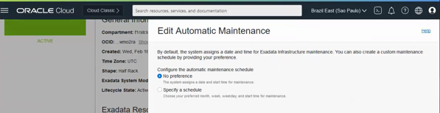
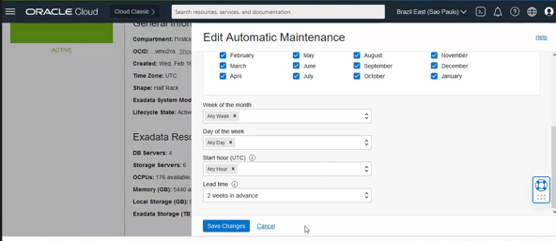
Patching Dom0
Using the Console to Configure Oracle-Managed
Infrastructure Updates
Exadata Cloud Service updates are released on a quarterly basis;
You can set a maintenance window to determine the time your quarterly infrastructure maintenance will begin.
Maintenance schedule options:
No preference: The system assigns a date and start time for infrastructure maintenance.
Specify a schedule: Choose your preferred month, week, weekday, start time, and lead time for infrastructure maintenance.
Confidential – © 2022 Oracle Internal/Restricted/Highly Restricted
Notes:
A Oracle disponibiliza Patches de segurança e vulnerabilidades a cada quarter para todos os componentes do ExaC@C Dom0 e DomU

Slide 14
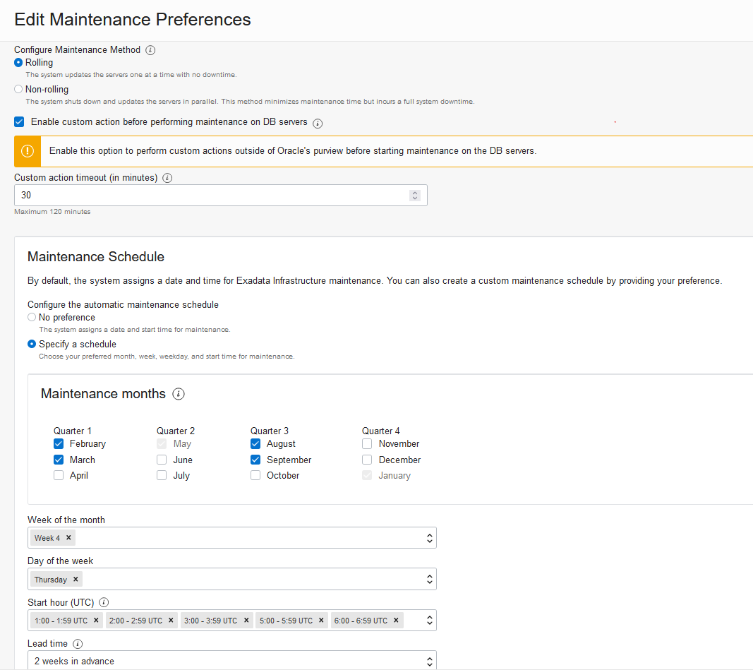
Patching Dom0
Configure Maintenance Method
For rolling update this option will force the maintenance run to wait for a custom action on each DB server;
For non-rolling update this option will wait for a custom action before starting maintenance across all DB server;
Maintenance pause may also be resumed prior to the timeout;
Custom action timeout (in minutes):
Default: 30 minutes
Maximum: 120 minutes
PRINT SCREEN
Confidential – © 2022 Oracle Internal/Restricted/Highly Restricted
Notes:
A Oracle disponibiliza Patches de segurança e vulnerabilidades a cada quarter para todos os componentes do ExaC@C Dom0 e DomU

Slide 15
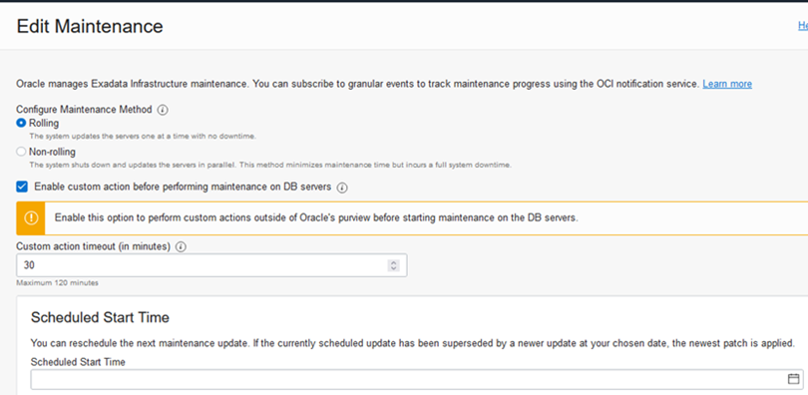
Patching Dom0
Reschedule the infrastructure maintenance
You can reschedule the infrastructure maintenance to a date no more than 180 days from the prior infrastructure maintenance
You cannot reschedule the maintenance if the current time is within 2 hours of the scheduled maintenance start time.
Oracle reserves certain dates each quarter for internal maintenance operations, and you cannot schedule your maintenance on these dates.
Confidential – © 2022 Oracle Internal/Restricted/Highly Restricted
Notes:
A Oracle disponibiliza Patches de segurança e vulnerabilidades a cada quarter para todos os componentes do ExaC@C Dom0 e DomU

Slide 16
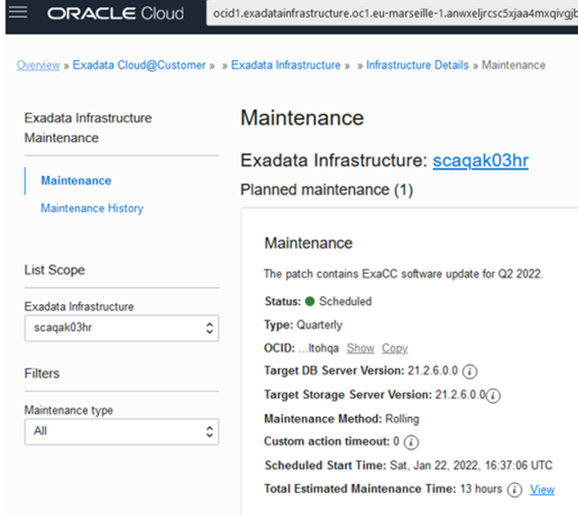
Patching Dom0
Check Estimated Maintanance Time
To view estimated maintenance time details for various components, click the View link is displayed in the Total Estimated Maintenance Time field.
The View link is displayed in the Total Estimated Maintenance Time field only if the Maintenance Method is Rolling.
PRINT SCREEN
Confidential – © 2022 Oracle Internal/Restricted/Highly Restricted
Notes:
A Oracle disponibiliza Patches de segurança e vulnerabilidades a cada quarter para todos os componentes do ExaC@C Dom0 e DomU

Slide 17
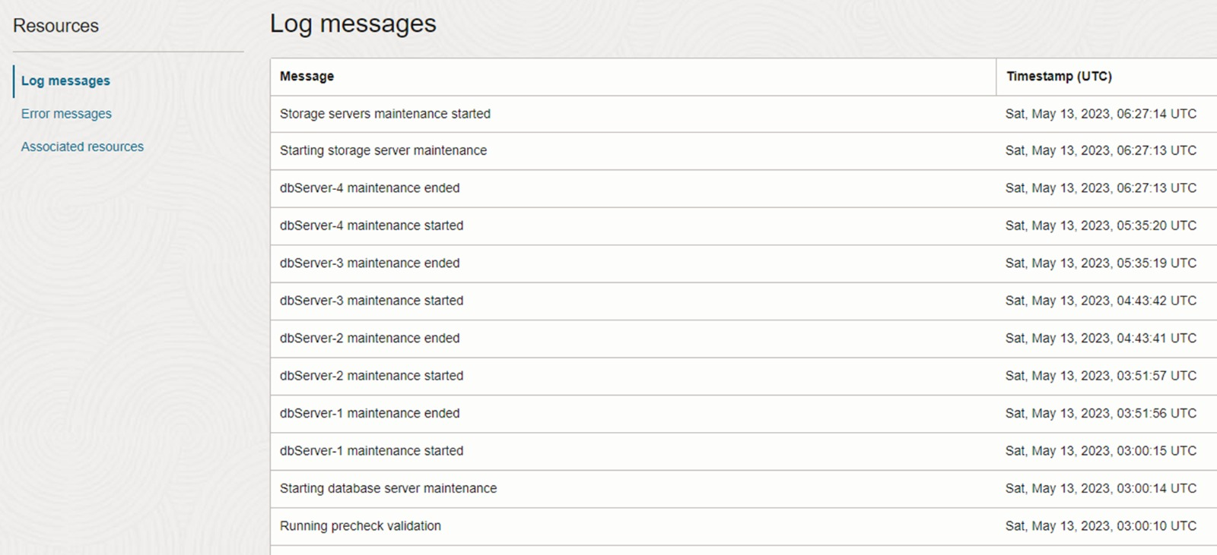
Patching Dom0
Check status Dom0 execution patching
PRINT SCREEN
Confidential – © 2022 Oracle Internal/Restricted/Highly Restricted
Notes:
A Oracle disponibiliza Patches de segurança e vulnerabilidades a cada quarter para todos os componentes do ExaC@C Dom0 e DomU

Slide 18
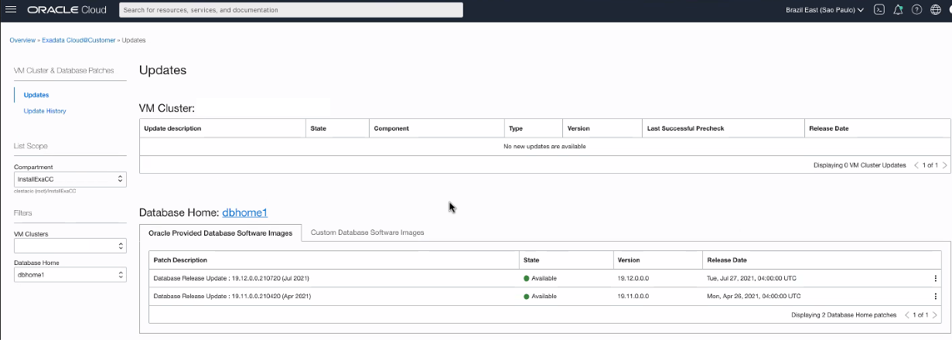
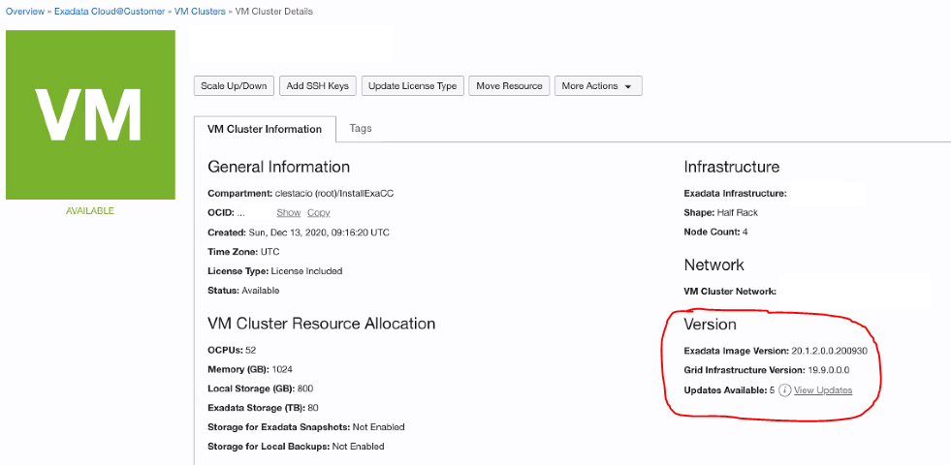
Patching DomU
DomU Components:
Patching Oracle Grid and Database Software
Updating Operating System
You can update DomU components through:
Console
CLI (dbaascli)
Confidential – © 2022 Oracle Internal/Restricted/Highly Restricted
Notes:
A Oracle disponibiliza Patches de segurança e vulnerabilidades a cada quarter para todos os componentes do ExaC@C Dom0 e DomU

Slide 19
Patching DomU
DomU Update Best Practices
Because patching a system requires a reboot, plan to run the operations at a time when they will have minimal impact on users;
Back up your databases before you apply any patches;
Your Oracle Grid Infrastructure must be at the same or higher version than the database version you want to patch to;
If production DBs have a DR, apply patches in it first;
Keep the patching at N or N-1 level.
Execute precheck before patch to fix any problem
Confidential – © 2022 Oracle Internal/Restricted/Highly Restricted
Notes:
A Oracle disponibiliza Patches de segurança e vulnerabilidades a cada quarter para todos os componentes do ExaC@C Dom0 e DomU

Slide 20
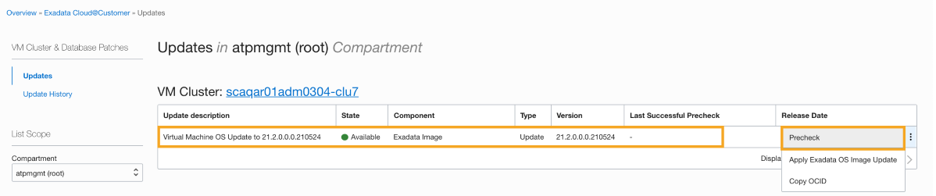
Patching DomU
Patching and Updating VM Clusters and Database Homes using Console
Select the patch you want to apply;
Execute Precheck;
Execute Apply Patch;
After patching you can check Update History.
Note: If the Exadata infrastructure containing this VM cluster is scheduled for maintenance that conflicts with the patching operation, the patch fails and the system displays a message explaining why. After the infrastructure maintenance is complete, run the patch operation again.
Confidential – © 2022 Oracle Internal/Restricted/Highly Restricted
Notes:
A Oracle disponibiliza Patches de segurança e vulnerabilidades a cada quarter para todos os componentes do ExaC@C Dom0 e DomU

Slide 21
Patching DomU
Using the Console to Move a Database to Another Home
You can update the version of a VM cluster database by moving it to a Database Home that is running the version of Oracle Database you are interested in.
Click the VM cluster where the database you want to move is located;
Under Resources, click Database Homes;
Click the Database Home you are interested in;
Click the database you are interested in;
Click Move Database;
Select the target Database Home;
Click Move Database;
Confidential – © 2022 Oracle Internal/Restricted/Highly Restricted
Notes:
A Oracle disponibiliza Patches de segurança e vulnerabilidades a cada quarter para todos os componentes do ExaC@C Dom0 e DomU

Slide 22
Patching DomU
Listing Available Software Images and Versions for Database and Grid Infrastructure
The command output lists the available database software images.
For database:
dbaascli cswlib showImages --product database
For Grid:
dbaascli cswlib showImage --product grid
Confidential – © 2022 Oracle Internal/Restricted/Highly Restricted
Notes:
A Oracle disponibiliza Patches de segurança e vulnerabilidades a cada quarter para todos os componentes do ExaC@C Dom0 e DomU

Slide 23
Patching DomU Manually
Patching Oracle Grid Infrastructure and Oracle Databases Using dbaascli
To patch an Oracle home, you can use the dbaascli dbHome patch command.
The following apply to using the dbHome patch command for in-place patching operations:
You can patch all of your database nodes or a subset of nodes;
Multi-node patching takes place in a rolling fashion;
You can perform a software-only patch operation. Then, when you are ready, you can run datapatch to perform post-patch SQL actions;
You can patch an Oracle home containing one or more databases.
dbaascli dbhome patch --oracleHome /u02/app/oracle/product/19.0.0.0/dbhome_2 --targetVersion 19.9.0.0.0
dbaascli grid patch --targetVersion 19.11.0.0.0
Confidential – © 2022 Oracle Internal/Restricted/Highly Restricted
Notes:
A Oracle disponibiliza Patches de segurança e vulnerabilidades a cada quarter para todos os componentes do ExaC@C Dom0 e DomU

Slide 24
Patching DomU Manually
Moving a Database to a Different Oracle Home (Out-of-Place Patching)
To patch an Oracle Database by moving it to an Oracle home that is already at the desired patch level, use the dbaascli database move command.
After the database move operation is complete, the database runs using the Oracle Database software version of the target Oracle Home.
Confidential – © 2022 Oracle Internal/Restricted/Highly Restricted
Notes:
A Oracle disponibiliza Patches de segurança e vulnerabilidades a cada quarter para todos os componentes do ExaC@C Dom0 e DomU

Slide 25
Patching DomU Manually
Updating Guest VM Operating System Manually
To update the operating system on the Database Server Virtual Machines (VMs), use the patchmgr tool.
The patchmgr utility manages the entire update of one or more virtual machines remotely, including the pre-restart, restart, and post-restart steps of an Oracle Exadata Database Service on Cloud@Customer system.
Run the precheck operation
./patchmgr -dbnodes dbs_group -precheck -iso_repo /root/patch/18.1.4.0.0.180125.3/exadata_ol6_18.1.4.0.0.180125.3_Linux-x86-64.zip -target_version 18.1.4.0.0.180125.3 -nomodify_at_prereq
Back up the current system
./patchmgr -dbnodes dbs_group -backup -iso_repo zipped_iso_file -target_version target-version -allow_active_network_mounts
Confidential – © 2022 Oracle Internal/Restricted/Highly Restricted
Notes:
A Oracle disponibiliza Patches de segurança e vulnerabilidades a cada quarter para todos os componentes do ExaC@C Dom0 e DomU

Slide 26
Patching DomU Manually
Executing patchmgr in background
Execute patchmgr in background to avoid issues in case of connection lost:
Use nohup command:
nohup ./patchmgr -dbnodes dbs_group -upgrade -nobackup -iso_repo zipped_iso_file -target_version target-version -allow_active_network_mounts &
Confidential – © 2022 Oracle Internal/Restricted/Highly Restricted
Notes:
A Oracle disponibiliza Patches de segurança e vulnerabilidades a cada quarter para todos os componentes do ExaC@C Dom0 e DomU

Slide 27
Patching DomU Manually
Executing patchmgr in background
Using screen command:
$ screen
$ screen -ls
There is a screen on:
4491.pts-2.FC547 (04/08/2021 01:13:24 PM) (Detached)
1 Socket in /run/screen/S- linuxconfig.
You can attach the screen at anytime by specifying the screen id as shown below. You can get the screen id from the “screen -ls” command output.
$ screen -r 4491.pts-2.FC547
Confidential – © 2022 Oracle Internal/Restricted/Highly Restricted
Notes:
A Oracle disponibiliza Patches de segurança e vulnerabilidades a cada quarter para todos os componentes do ExaC@C Dom0 e DomU

Slide 28
Thank you
Cloud Specialist Oracle Customer Success

